Slide 1
“The (Lack of) Anticipatory Effects of the Social Safety Net on Human Capital Investment”
Paper by Manasi Deshpande & Rebecca Dizon-Ross (2022)
Summary & comments by Kelsey Pukelis
Harvard Economics of Health Equity Reading Group
March 2, 2023

Slide 2
Research question
Do parents invest less (more) in children’s human capital if they know their children will (not) receive social safety net benefits as adults?
In other words, is there a “dynamic discouragement effect” of safety net benefits?

Slide 3
Why this matters: economic theory
Life-cycle models assume that agents choose human capital investment in early life to maximize aggregate utility over the life cycle
Intuition: if you expect your future consumption to be supported by govt transfers (i.e. non-work), you have less incentive to invest in human capital today
Basis of theoretical models of human capital accumulation, macro models
(e.g., Guvenen et al., 2014; Heathcote et al., 2017; Stantcheva, 2017; Luduvice, 2021; Daruich and Fernandez, 2020)

Slide 4
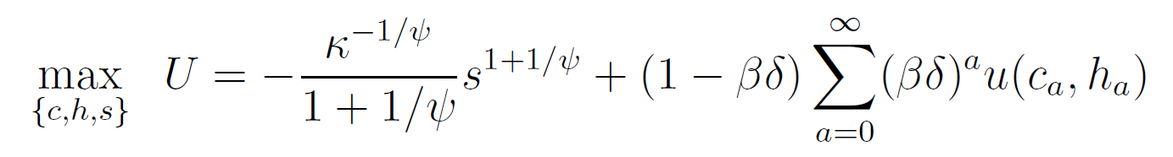
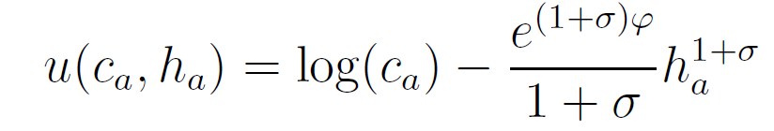

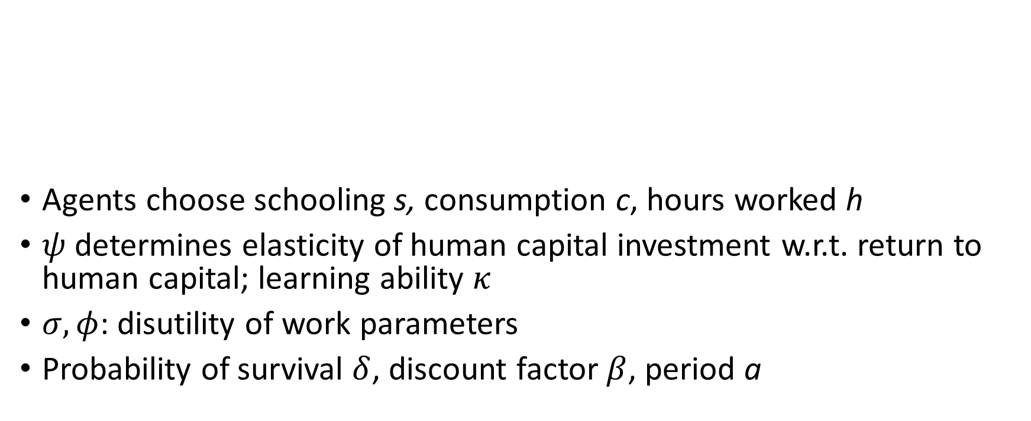
Model details (Heathcote et al. 2017)
Disutility of schooling today
Future utility streams
Agents choose schooling s, consumption c, hours worked h
$ψ$ determines elasticity of human capital investment w.r.t. return to human capital; learning ability $κ$
$σ, φ$: disutility of work parameters
Probability of survival $δ$, discount factor $β$, period a
Disutility of work

Slide 5
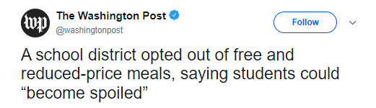
Why this matters: American politics
“Karin Rajnicek, a school board member, said the free [universal school lunch] program made it easy for families to ‘become spoiled.’”
“Darren Clark, assistant superintendent for business services, said there could be a ‘slow addiction’ to the service.”
(slightly different, but related to dynamic discouragement effect)

Slide 6
Why this matters: cost of redistribution
Dynamic discouragement effects make redistribution more costly
don’t invest in human capital → earn less as adults → less in taxes collected
“Our finding of zero dynamic discouragement implies that redistribution is less costly and that income can be redistributed more efficiently.”

Slide 7
Why is estimating a dynamic discouragement effect challenging?
Hard to isolate the anticipatory effect of future benefits from the contemporaneous effect of benefits
How to exogenously vary expectations of future benefits?

Slide 8
Key idea for this paper
Uninvesting in children requires that parents expect children to continue receiving benefits as adults
In reality, many children DO NOT continue receiving benefits as adults
Parents don’t know this
Claim: These inaccurate beliefs about the likelihood of future benefits could lead parents to underinvest in their children’s human capital.
Idea: correct beliefs w/ info intervention, see if parents’ investment behavior increases
If so, then supports the hypothesis of dynamic discouragement effect

Slide 9
Why might parents underinvest in children’s human capital?
Income effect: “because they do not expect their child to ‘need’ money from working in the future”
“expected government transfers reduce the child’s expected marginal utility of earned income in the future”
Substitution effect: because of the phase-out design of transfer programs, a child’s adult benefits will be reduced if they work as an adult

Slide 10
Outline
SSI context & removals
Experimental design
Results
Mechanisms
Discussion, especially takeaways for young researchers

Slide 11
Study context: SSI & removals

Slide 12
Context: SSI basics
Supplemental Security Income (SSI) = cash welfare program for disabled children and adults
Totals
$51 billion in cash payments in 2022
1.0 million children
5.5 million adults
Focus on children
Cash benefits
Most receive $10,000 / year = 50% of household income
(Other 50% comes from parent earnings)
Categorical eligibility for Medicaid (most states)

Slide 13
SSI medical eligibility
Disability definition differs between children + adults
Adults: inability to work
Specifically, inability to earn more than $1,350 / month: “substantial gainful activity”
Children: functional limitations that limit age-appropriate activity
Including social interaction and school performance
This makes removal from SSI very likely at age 18 medical reviews

Slide 14
How do medical conditions differ b/w adults & children?
Category | % adults, SSDI | % children, SSI
Musculoskeletal conditions | 29.7 | n/a
Mental disorders | 20.1 | 73
- Intellectual | n/a | 49
-Other | n/a | 25
Other disabilities | 50.2 | 18
- Cancers | 11.6 | n/a
- Cardiovascular conditions | 10.3 | n/a
 | Sample is all new DI beneficiaries from 1997 to 2009, N ≈ 3,000,000. Source: Gelber et al. (2019). | Sample is SSI children with an 18th birthday within 37 weeks of the August 22, 1996 cutoff. Source: Deshpande (2016).

Slide 15
SSI medical eligibility
Different SSI eligibility criteria for adults and children leads to large removals of the caseload at age 18
40% removal rate of all SSI children
70% removal rate of SSI children with mental and behavioral conditions

Slide 16
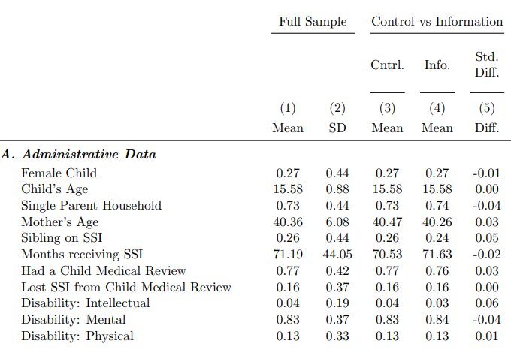
Summary stats, experimental sample
Condition | % of sample
ADHD | 43%
Speech / language delays | 15%
Learning disorder | 7%
Autistic + other pervasive disorders | 5%
Oppositional / defiant disorder | 5%

Slide 17
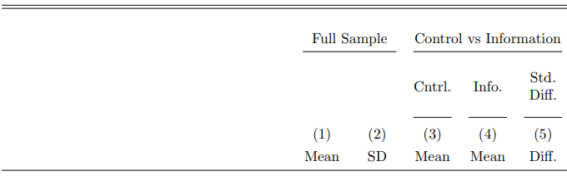
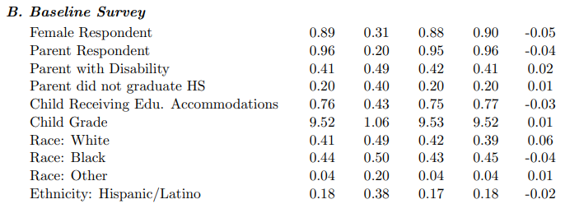
Summary stats, experimental sample, cont.

Slide 18
Financial eligibility for SSI
Max annual amount for:
An individual in 2022: $10,092
A couple: $15,137 (ssa.gov)
Amount is reduced by income, including:
earned income
unearned income
cash & in-kind benefits
Most children qualify for max annual benefit of ≈$10,000

Slide 19
SSI benefit size
Financial eligibility for SSI in adulthood
$10,092
Benefit reduction rate = 50%
Earned income
Small amount
excluded
$18,000

Slide 20
Baseline human capital investments in SSI kids
Vocational rehabilitation services
Goal: prepare disabled youth for postsecondary education and/or employment
Take-up rates very low: 10-15%
High school completion rate: 48%

Slide 21
Relationship between parent and SSI child
61% of parents say their child will continue living with them in adulthood
65% of young adults who received SSI as children actually live with their parents in adulthood (National Survey of SSI Children and Families)
30% of parents say they will support their child, even if the child lives separately

Slide 22
Aside: SSI removal consequences
Youth removed at age 18 recover ≈1/3 of lost cash income through earnings (Deshpande 2016)
Youth removed at age 18 make up some lost income through criminal activity (Deshpande & Mueller-Smith 2022)
SSI removal increases criminal charges by 20% over the next two decades
Shocking fact: removed youth are “twice as likely to be charged with an illicit income-generating offense than they are to maintain steady employment at $15,000 / year”

Slide 23
Experimental design

Slide 24
Key idea for this paper
Uninvesting in children requires that parents expect children to continue receiving benefits as adults
In reality, many children DO NOT continue receiving benefits as adults
But parents don’t know this
Idea: correct beliefs using information intervention in RCT
identify effect of beliefs about the availability of SSI in adulthood → parents’ human capital investments in their children
Recall: Isolate the anticipatory effect from contemporaneous effect

Slide 25
Parents’ inaccurate beliefs about removal
Beliefs about removal rates are very inaccurate
(All #’s below are from the experimental sample)
Range of predicted “truth”: 35% - 95%
2/3 of SSI child recipients
Avg “truth”: 70%
Avg belief: 20%
More than half of parents think there is a 0% chance of removal
Note: people may behave even differently in the face of this certainty

Slide 26
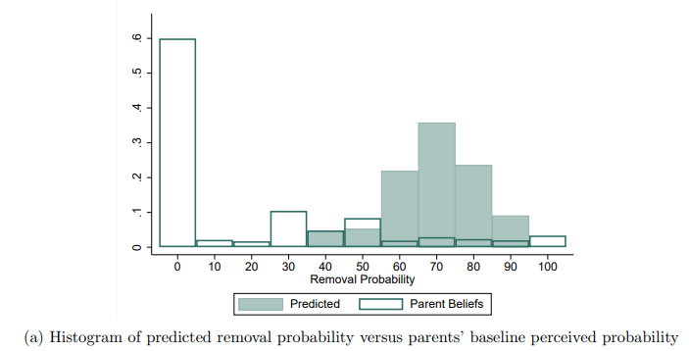
Parents’ inaccurate beliefs about removal

Slide 27
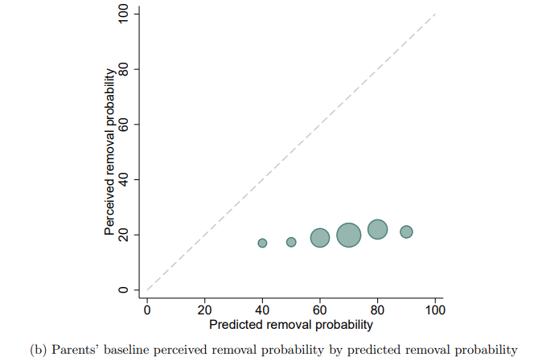
Parents’ beliefs are uncorrelated with “truth”

Slide 28
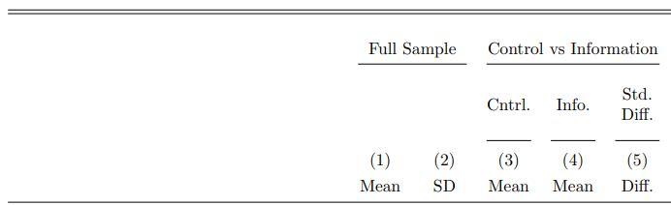
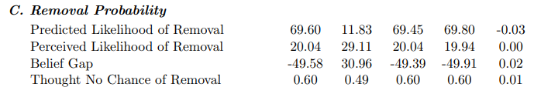
Parents’ inaccurate beliefs about removal

Slide 29
Study sample
Sampled 37,000 parents of SSI children from SSA admin data
Stratified by state & above/below-median removal probability within state
National sample, with oversampling from states with extra admin data for additional outcomes
Children close to age of removal (aged 14-17)
Mailed letters with info on web survey + reminders
17% sample inclusion rate → N ≈ 6,000
SSA admin data shows no meaningful selection of final sample

Slide 30
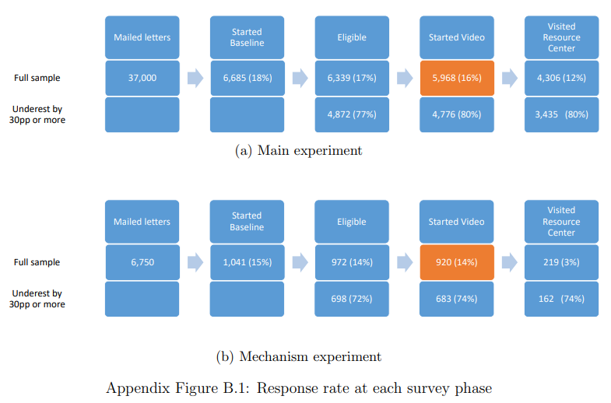

Slide 31
Info Treatment
Treatment groups received tailored information on their child’s predicted likelihood of SSI removal at age 18
“[Your child] will most likely not receive SSI benefits as an adult. If that happens, they will not receive any monthly payments from SSI...and they will need to find other sources of income to support themselves.”

Slide 32

Info Treatment: https://youtu.be/57jvdStkhd4

Slide 33
Control groups
Goal of intervention for control groups: maintain similar length and salience of SSI, but with innocuous information:
Geography: info about the geographic distribution of child SSI recipients across the U.S.
History: info about the history of the SSI program
Front and end of video kept the same

Slide 34
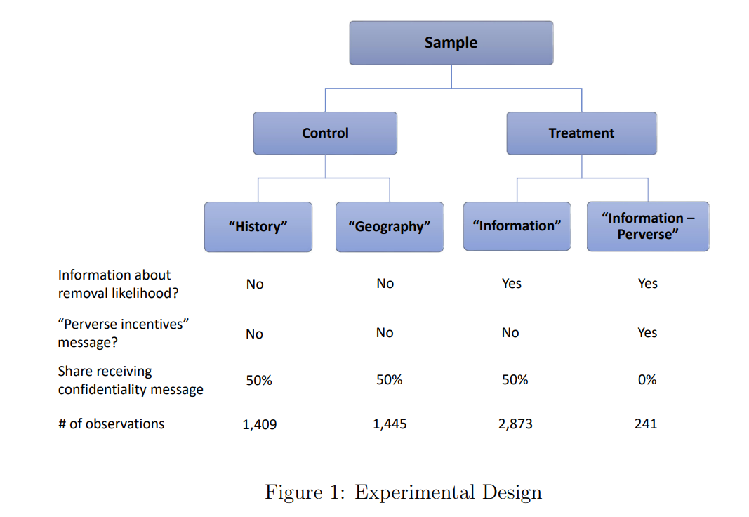

Slide 35
Primary outcomes: parents’ investments in human capital
 | Temporal (time cost) – through “Resource Center” | Financial ($ cost) – outside “Resource Center”
Education | Enrolling in online math courses tailored to student’s grade | Choosing $300 of one-on-one tutoring over $50 cash in survey lottery
Employ-ment | Enrolling in job training offered by state vocational rehabilitation agencies | Choosing $35 cash + career guide book (worth $16) over $40 cash in survey payment

Slide 36
Secondary outcomes (survey)
Parents’ intentions for children to attend college
Parents’ intentions for children to work in young adulthood.
Parents’ interest in saving for their child’s future
Provide info on ABLE savings accounts in the Resource Center
Outcome: requesting an email for how to sign up

Slide 37
Strengths: outcome measurement
Primary outcomes intend to capture different channels of possible effects
Outcomes were selected based on extensive pilots and focus groups & calibrated for power
E.g. in pilots about half preferred $300 in tutoring to $50 cash
Can show that participants value these resources
Revealed preference: 30% take-up among control group
For 3 of 4 outcomes, most parents say the resource would be “extremely” useful
Evidence supports that outcomes (e.g. job training) are worthwhile, economically meaningful investments

Slide 38
Discussion: outcome measurement
What if families still don’t value these offered resources?
E.g. if families’ desired investments in human capital are more “lumpy”
Minor concern: perceived likelihood of winning tutoring vs. cash, based on what other people might be choosing?
This makes me almost more interested in the secondary outcomes
Although there’s a clear argument against using stated beliefs

Slide 39
Results

Slide 40
Immediate “outcomes” checking that videos were understood
Knowledge check questions
E.g. what fraction of children with their child’s removal probability were removed at age 18
≈75% answer correctly on first round
≈96% answer correctly on second round

Slide 41
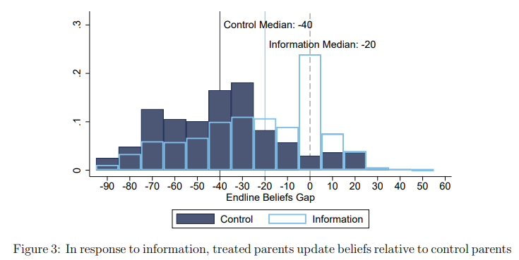
First stage: treated parents update beliefs based on info
Perceived likelihood of removal (-20 pp)

Slide 42
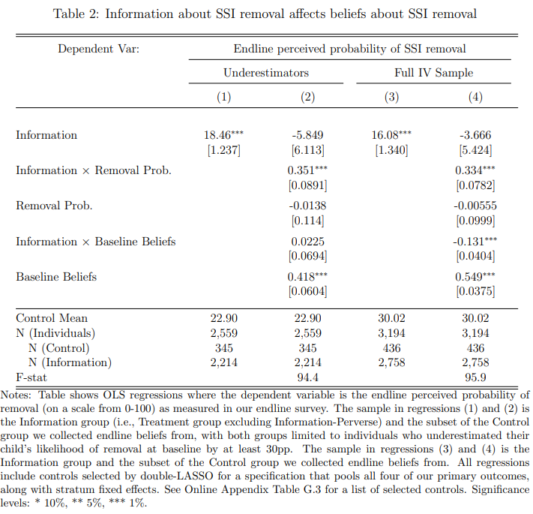
First stage
Main reduced-form results limit to “underestimators”: 80% of individuals who underestimate likelihood of removal by 30pp+

Slide 43
First-stage: beliefs persisted in the short-run
End of Resource Center: asked 5-point Likert scale question about likelihood of removal
50% response rate among those eligible to answer question
Treatment effect is similar to endline survey
Concern: Will beliefs persist in the medium- or long-run?
In main experiment, this is still the same day
In small mechanisms experiment, this is 11 days later, on average
Challenge: getting people to come back for additional survey rounds

Slide 44
First stage robustness: beliefs affect slightly different intermediate outcomes
Small mechanism experiment: N = 1,000 ⬄ 14% response rate
Treatment increased demand for a hypothetical insurance product to insure against the loss of SSI benefits (+10 pp)
Treated group has more negative emotions
More likely to report feeling “discouraged”
Less likely to report feeling “hopeful”
→ possible effects of interventions on parent mental health in LR?

Slide 45
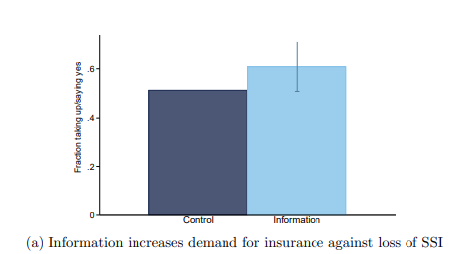
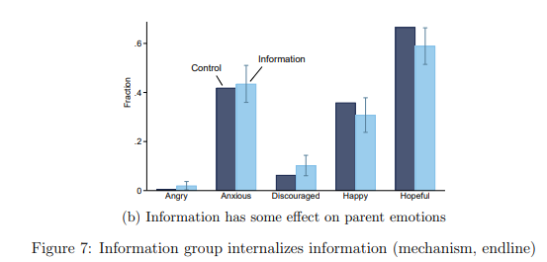

Slide 46
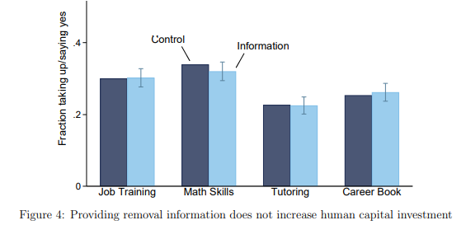
Zero effect on investments in children’s human capital

Slide 47
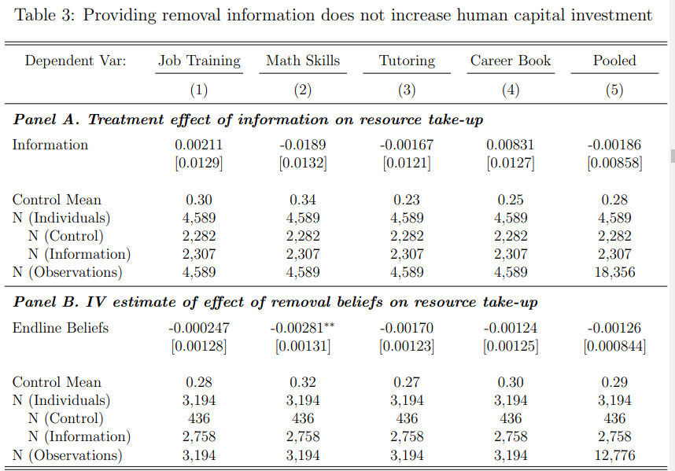

Slide 48
How precise is the null effect?
Pooled estimate can rule out that information increased take-up of the investments by more than 1.5pp, of a base of about 29%.
1.5pp is small relative to differences in investments between different subgroups:
parents who do / do not believe college has a high return (8 pp)
Parents above / below median “it’s too early to plan for my child’s future” (11 pp)
Parents who think resources are extremely useful / not (17 pp)

Slide 49
How precise is the null effect?
Can rule out effects larger than 5%
(5% = 1.5 pp over control mean 28%, from pooled estimate)
A relevant model (Heathcote et al. 2017) predicts the info intervention should increase investments by 11%
Qualitative interviews with counselors who work with SSI families predicted positive effects
Expert survey
97% predicted a positive effect
Avg expert prediction: 34% (14 pp)

Slide 50
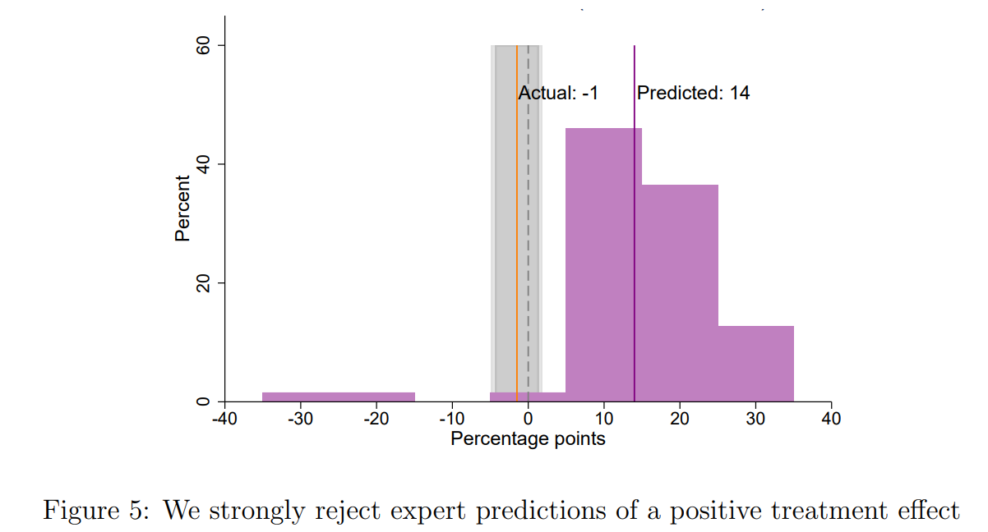
How precise is the null effect? Expert survey

Slide 51
Mechanisms

Slide 52
Mechanisms set-up
Parents understand income effects…
A majority believe that losing SSI would be a major financial shock
81% of treated parents said they would be “much” or “somewhat” worse off
…and understand substitution effects…
i.e. they understand that receiving SSI benefits as an adult decreases the financial returns to work
~2/3 of parents perceive the marginal tax rate to be 50% (correct) or 100%

Slide 53
Mechanisms set-up
…and they believe that human capital investments would increase earnings…
Nearly 80% of parents say high school would increase their own child’s earnings from work “a little” or “a lot”
Many parents say 4-year college would increase their children’s earnings enough to cover the cost
…and have (over)-optimistic beliefs in their children’s abilities.
64% think their child could attend college
84% expect their child to have a part-time or full-time job in adulthood
Why then do these updated beliefs not translate into more human capital investment?

Slide 54
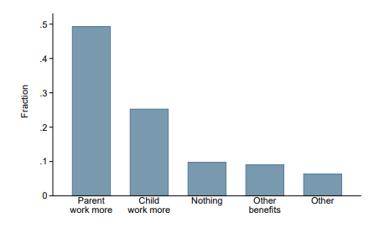
Why don’t parents invest? Key factor
Treatment increased parents plans to work more to recover the lost income (+9 pp)
From small mechanism experiment: N = 450

Slide 55
Why don’t parents invest? Medium factors
Non-financial objectives
E.g. wanting their child to achieve their potential
E.g. key margin is high school completion, and want to avoid the stigma of dropping out of high school
Parents are close to time, $, and bandwidth constraints for making investments in children

Slide 56
Why don’t parents invest? Less relevant factors
Wealth effect: loss of permanent SSI income → decrease in college-going plans
Suggests that parents believe they can no longer afford college without SSI
But cannot account for null treatment effect
for e.g. job training (an alternative to college)
& still no treatment effect among parents who are less credit constrained
High discount rates (i.e. impatience, not forward-looking)
No evidence to support

Slide 57
Study takeaways
Internal validity of this study is quite convincing
A “template paper” for running a beliefs-related experiment
External validity is more shaky
Do we think these results apply to other, particularly non-disabled, populations?

Slide 58
External validity considerations
What if effects are asymmetric?
i.e. if the effect of taking (expected) benefits away is not the same as providing new benefits?
What if parents expect to be responsible for taking care of their disabled child?
What if SSI households face more constraints on human capital investment than the average household?
Potential to consider real human capital investments using admin data in the future?

Slide 59
Takeaways for young researchers

Slide 60
Research-related lessons: general
A project where null effects are interesting
Rewards to depth of contextual knowledge
I suspect that authors did not expect to do this project, until learning how inaccurate beliefs were
connections to admin data
oversampling in states where they had connections to state admin data for later outcomes
Sampling from admin data to test selection into experiment

Slide 61
Research-related lessons: experiments
A lot of background qualitative work and piloting
E.g. to determine video was the best way to communicate info to parents
Running an information intervention: stages of intermediate outcomes to show that the intervention worked
Validating unconventional outcome measures
i.e. checking that stated and revealed preference showed that parents value the resources they offered (e.g. tutoring)

Slide 62
Thank you!

Slide 63
Appendix: perverse incentives

Slide 64
Ruling out an alternative effect
Alternative effect they want to rule out: “perverse incentive effect”
If parents believe that children with higher human capital are more likely to be removed…
…then increasing the perceived likelihood of removal (through the info intervention) could lead parents to actually decrease human capital investments (to prevent SSI removal).
Would offset main treatment effect of info potentially increasing human capital investment

Slide 65
2 sub-treatments to address possible “perverse incentives” channel
1) Confidentiality: Parents also told that their take-up of resources will be kept confidential
i.e. It would not affect their child’s chances of removal
Meant to dampen perverse incentives
Cross-randomized
2) Info-perverse: provide true information about what factors SSA considers in the age 18 removal decision
i.e. so that parents could know – and potential control – what factors do / do not affect removal
Meant to amplify preserve incentives
Separate treatment arm

Slide 67
Evidence against this hypothesis
At baseline: if anything, parents thought that having higher human capital leads to a lower (not higher) likelihood of removal
No effect of “perverse incentive” sub-treatments
So the authors largely ignore this when discussing the main results

Slide 68
Appendix: Extras

Slide 69
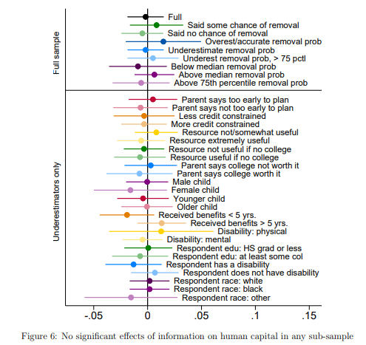
Null results across subgroups (pooled specification)

Slide 70
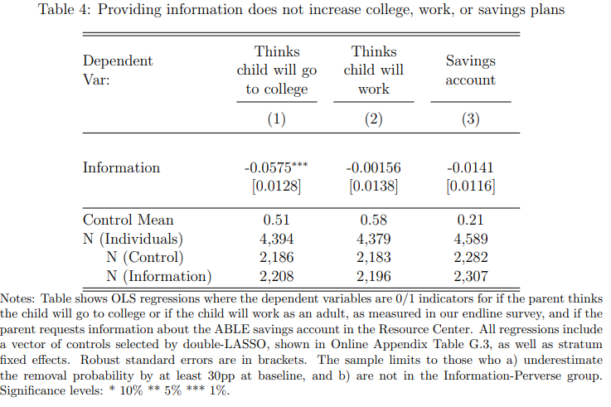
Null or opposite effects on secondary outcomes

Slide 71
Aside: IV specifications
Instrument for endline beliefs (D) using:
Information
Information X actual removal probability
Information X baseline perceived removal probability
Intuition for interactions: reduce monotonicity concern
Effects of info intervention could be non-monotonic since parents could update beliefs upward or downward, based on initial beliefs
IV results are also nulls, as expected given null reduced-form effects

Slide 72
Survey belief questions
Do you think there’s any chance [KID] will stop receiving SSI benefits over the next 10 years? [No, there is no chance that [his/her] benefits will stop. / Yes, there is some chance that [his/her] benefits will stop.]
(If “Yes”) How likely do you think it is that [KID] will stop receiving benefits? [10% (highly unlikely to lose benefits) / 20% (unlikely) / 30% (some chance) / 40% (could very well) / 50% (good chance) / 60% (likely) / 70% (probably) / 80% (most likely) / 90% (almost certainly) / 100% (certainly will lose benefits)]

Slide 73
Aside: predicting SSI removal probability
OLS prediction: Regressed an indicator for not being on SSI at age 19 on:
Sex
diagnosis (primary and secondary diagnosis code)
medical diary (which determines how often they face review, generally based on severity or expected recovery)
family structure
# of years on SSI
# of moves
age at last medical review
number of older siblings who received SSI
Race
parental earnings
3-digit zip code
R-squared = 0.216
Applied to the universe of all current SSI recipients
Tried fancier ML things (e.g. LASSO), but ended up just going with OLS

Slide 74
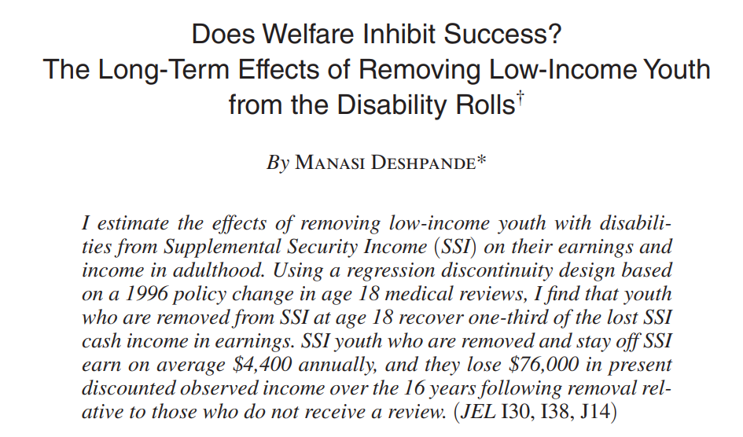
Deshpande (2016)

Slide 75
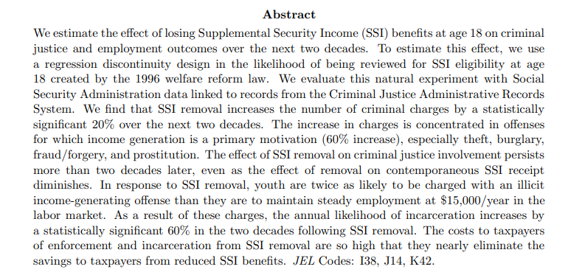
Deshpande & Mueller-Smith (2022)

